Slide 1
Case Study
Autonomous Cars

Slide 2
Sebastian Thrun’s TED Talk describing Google’s driverless car
www.ted.com/talks/sebastian_thrun_google_s_driverless_car.html

Slide 3
Junior: The Stanford Entry in the Urban Challenge
http://robots.stanford.edu/papers/junior08.pdf

Slide 4
DARPA Urban Challenge
November 3, 2007
6 hours to complete a 96 km urban area course
multiple robotic vehicles carrying out missions on the same course at the same time
basic rules:
stock vehicle
obey California driving laws
entirely autonomous
avoid collisions with objects typical to urban environment
must also be able to operate in parking lots
DARPA supplied environment map with information on lanes, lane markings, stop signs, parking lots, and special checkpoints

Slide 5
Junior

Slide 6
Junior: Computation

Slide 7
Junior: Sensors
Applanix POS LV 420 position and orientation system
multiple GPS receivers, GPS heading measurement, inertial measurement, distance measurement, Omnistar Virtual Base Station
position and orientation errors less than 100 cm and 0.1 degrees
2 side facing SICK LMS laser range finders
1 forward facing RIEGL LMS-Q120 laser range finder
1 roof mounted Velodyne HDL-64E laser range finder
2 rear mounted SICK LDLRS laser range finders
2 front mounted IBEO ALASCA XT laser range finders
5 BOSCH radars mounted in front grill

Slide 8
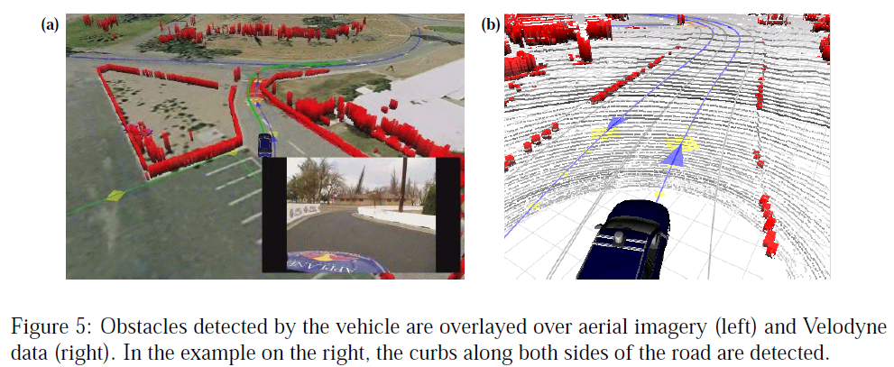
Laser Obstacle Detection
challenging!
curbs
moving and static obstacles
overhanging obstacles (tree branches, signs, etc.) that can be safely driven under

Slide 9
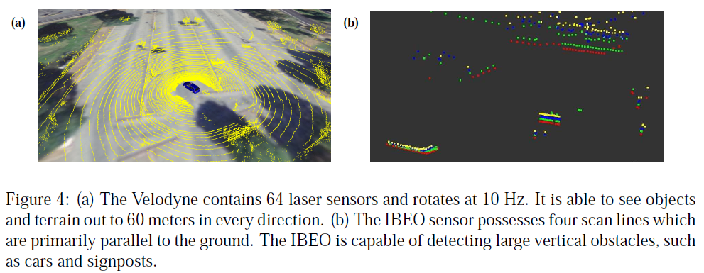
Laser Obstacle Detection
primary sensor is the Velodyne laser range finder
cannot reliably detect curb-sized obstacles near the vehicle because of self-occlusion

Slide 10
Laser Obstacle Detection
curbs near the vehicle detected using the 2 front facing IBEO laser range finders and 2 rear facing SICK laser range finders
only obstacles close to the vehicle (5m in front and 15m in back) considered

Slide 11
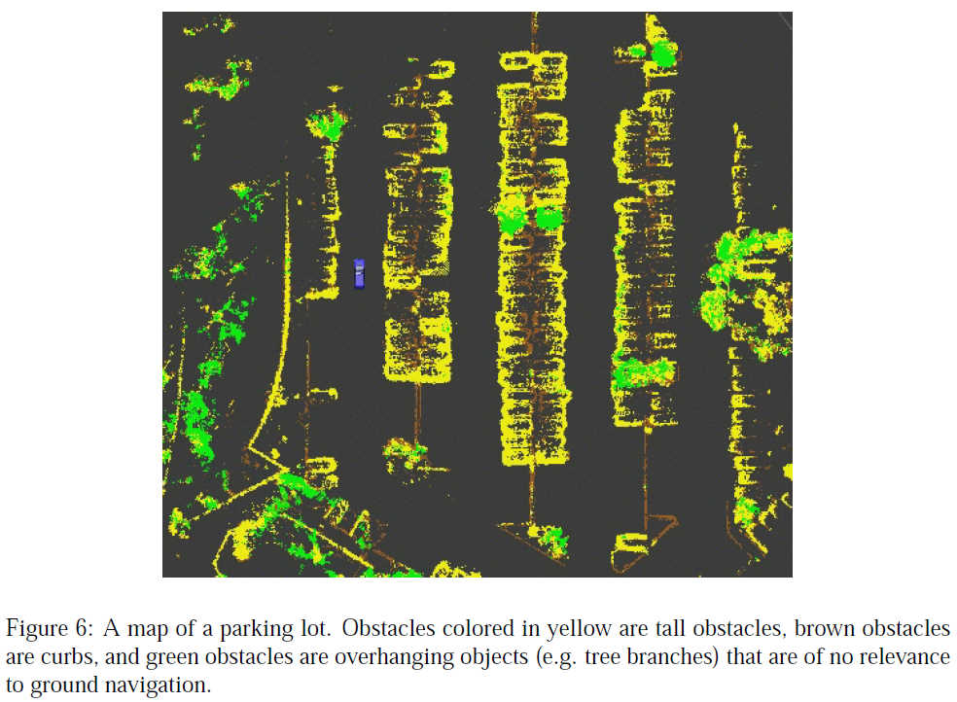
Static Mapping
discrete grid-based local maps based on laser scan data

Slide 12
Static Mapping

Slide 13
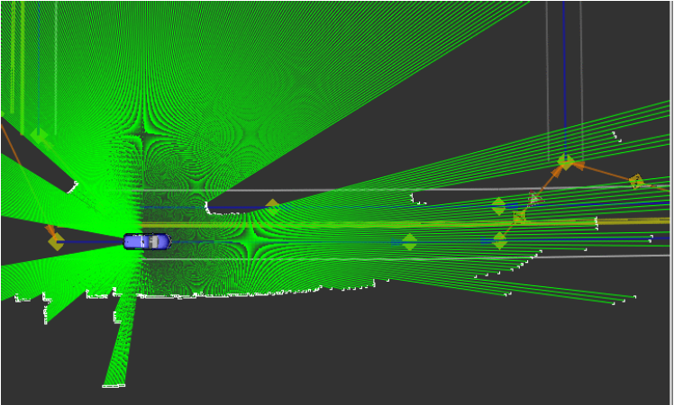
Dynamic Object Detection and Tracking
laser range scan data is mapped into a synthetic 2D scan of the environment

Slide 14
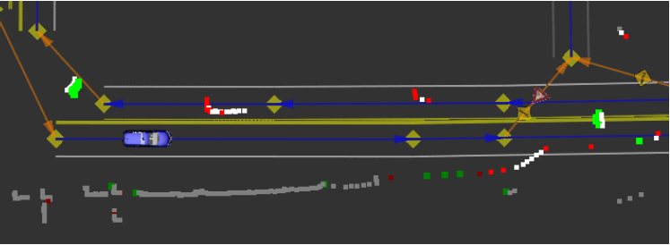
Dynamic Object Detection and Tracking
areas of change are detected by comparing two synthetic scans taken over a short time interval
if an obstacle in one scan falls in the freespace of the second scan then this is evidence of motion
new obstacle
absence of a previously seen obstacle

Slide 15
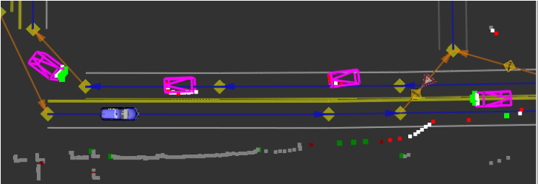
Dynamic Object Detection and Tracking
particle filters are instantiated at each detected moving obstacle to track the object over time

Slide 16
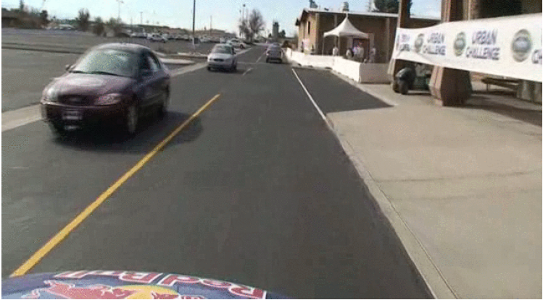
Dynamic Object Detection and Tracking
camera view

Slide 17
Precision Localization
high precision GPS and inertial measurements are not sufficiently precise to achieve single lane localization in the DARPA supplied map
DARPA map is also inaccurate!
high precision localization within the lane is achieved using curb measurements and road reflectivity
2 side facing SICK LMS and the forward facing RIEGL LMS-Q120 laser range finders pointed downward to measure infrared reflectivity change between road surface and painted lane markers
offsets greater than 1 m relative to GPS were common observed

Slide 18
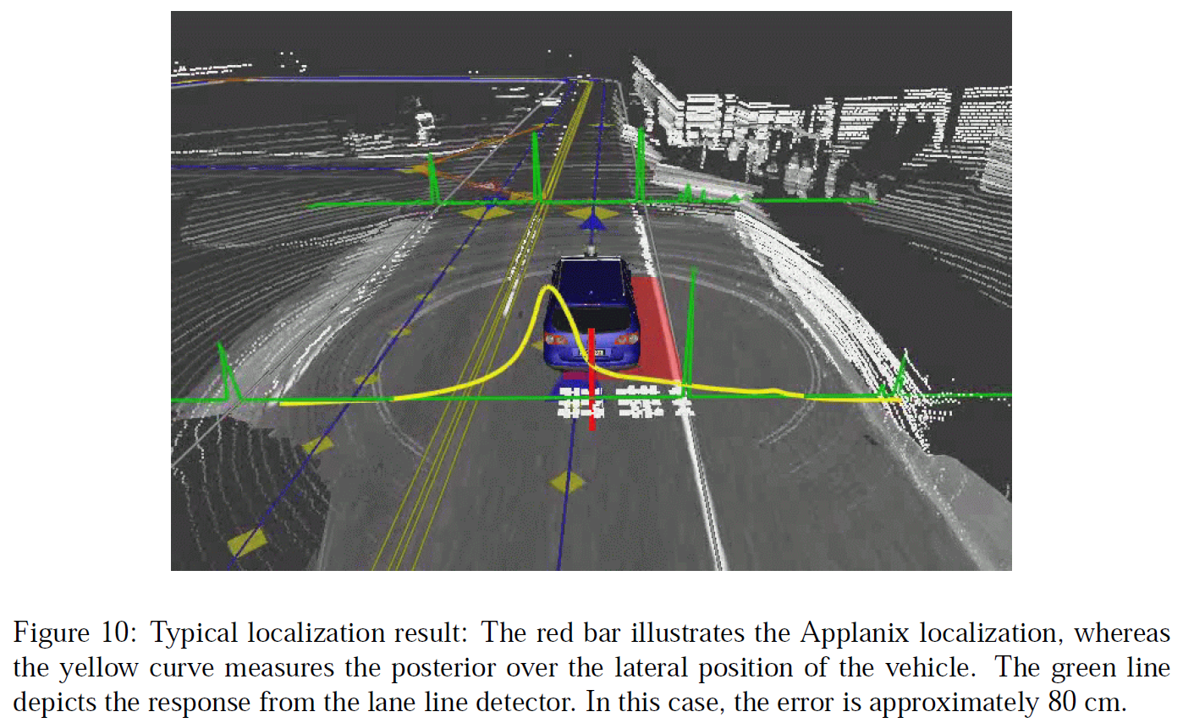
Precision Localization

Slide 19
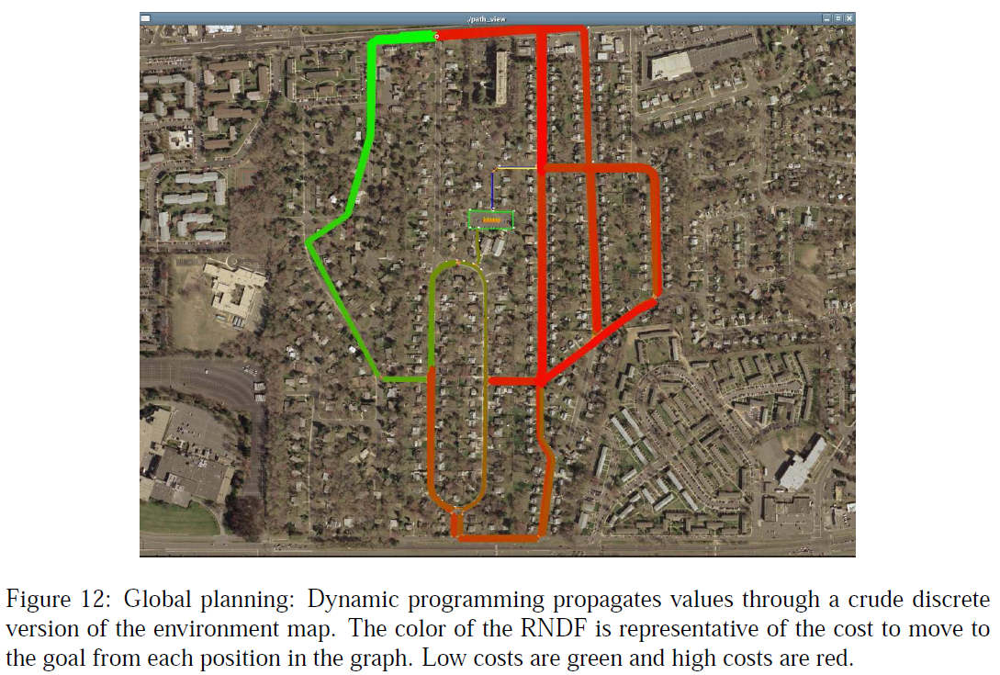
Global Path Planning
performed at each checkpoint and when a permanent road blockage is detected

Slide 20
Global Path Planning
performed using dynamic programming on a discrete version of the map
cost function weights choices (which way to turn at an intersection, lane changes, etc.) probabilistically
tends to perform lane changes earlier rather than later
will avoid passing a slow moving car in the right lane if a right hand turn is up coming
may decide against left hand turns at intersections if an alternate route is not much longer

Slide 21
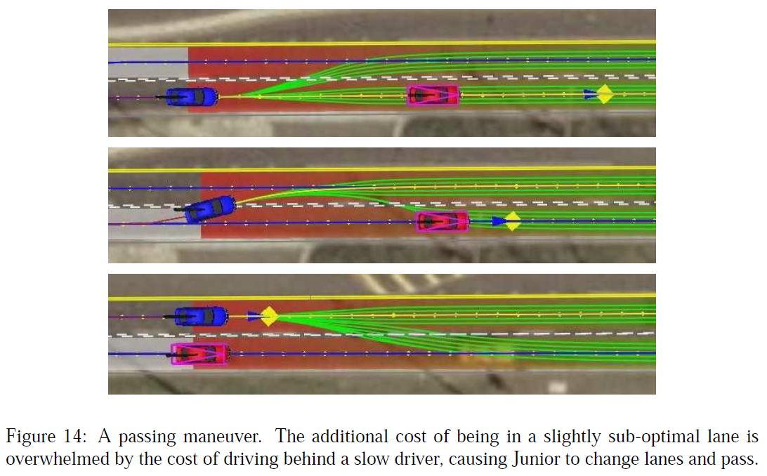
Road Navigation
global planner outputs a central path and also paths that have slight lateral shifts
allows the vehicle to pass slower moving vehicles

Slide 22
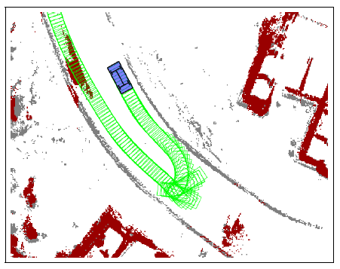
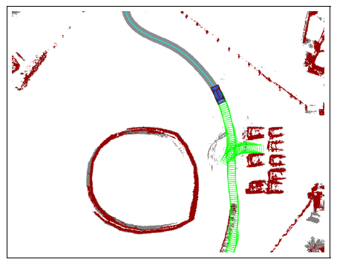
Freeform Navigation
used in parking lots and maneuvers such as U-turns
planning performed using a variation of A* called hybrid-A*

Slide 23
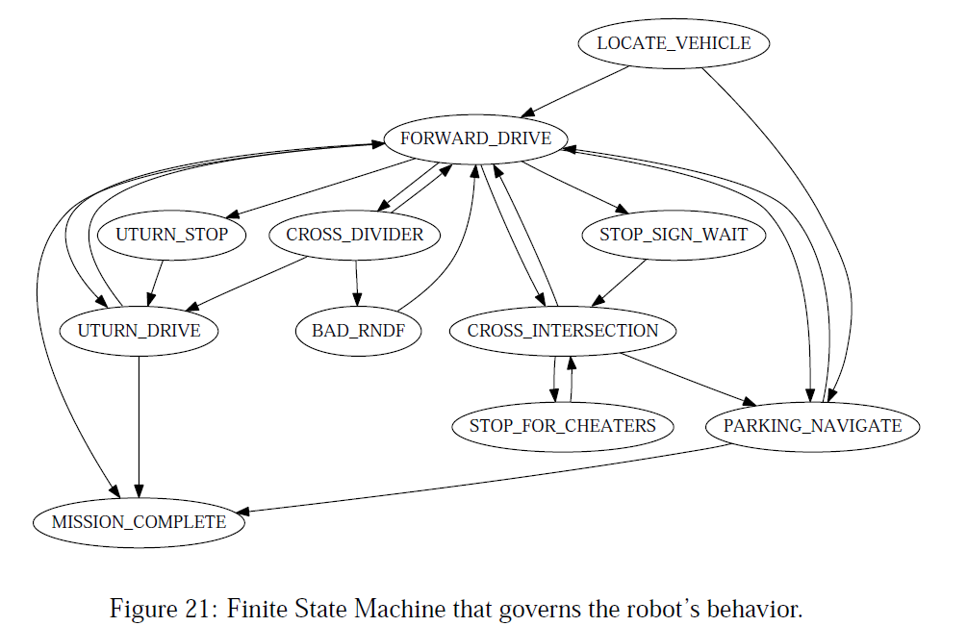
Behavior Hierarchy
behavior governed by a finite state machine
not shown
*TRAFFIC_JAM
*ESCAPE

Slide 24
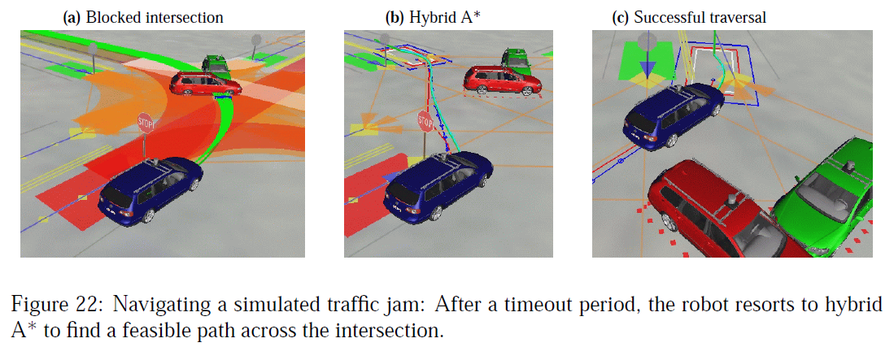
Escaping Blockages
TRAFFIC_JAM and ESCAPE use hybrid-A* planner to find a path around road blockages

Slide 25
Results
all 3 missions accomplished
55.96 miles in 4 hrs 5 mins 6 secs (22 km per hour)
good for 2nd place
notable race events
travel over a dirt road
passing a disabled competitor
avoiding a head on collision with a competitor driving partially in the wrong lane
braking in reaction to an aggressive merge
guilty of an aggressive merge
guilty of pulling alongside a competitor stopped at a stop sign (mistaken for a parked car)

